Slide 1



WorldFAIR Project (D8.1) Urban Health Data – The SALURBAL Project
Ana Ortigoza, Kari Moore, Alex Quitesberg,
Ran Li, Usama Bilal, Mariana Lazo, Ana Diez Roux
IASSIST Conference 2023
June 2nd, 2022
Notes:
Hi Everyone, my name is Ran I will be presenting alongside and Ana O. to introduce some of the work we have done in building the SALURBAL data portal. Unfortunately, Andrea is not feeling well so will not be joining us today so it’ll just me Ana and I.

Slide 2
Acknowledgements
SALURBAL Data Methods Core
Kari Moore
Goro Yamada
Alex Quitesberg
Usama Bilal
Ran Li
Mariana Lazo
Steve Melly
Ana Diez Roux
SALURBAL Country Teams
WP08 Group
Simon Hodson – CODATA
Arofan Grgory – DDI
Ana Ortigoza – SALURBAL
Ran Li - SALURBAL
FAIR Renovation Team
Jessica Uruchima
Ana Lucía Peralta
Diana Higuera
Notes:
Here is an overview of the presentation.
We will start with an introduction to the motivations behind the project.
Then look at some work on renovating SALURBAL infrastructure in the context of FAIR data principles and working group 8 project.
Followed by a quick demo of the data portal.
Then take a brief look at the development process before concluding with next steps.

Slide 3
Overview
Introduction to SALURBAL
Story 1: Data Harmonization
Story 2: FAIR Implementation
FAIR Implementation Lessons
Notes:
Here is an overview of the presentation.
We will start with an introduction to the motivations behind the project.
Then look at some work on renovating SALURBAL infrastructure in the context of FAIR data principles and working group 8 project.
Followed by a quick demo of the data portal.
Then take a brief look at the development process before concluding with next steps.

Slide 4
SALURBAL Introduction
The Salud Urbana en América Latina (SALURBAL),Urban Health in Latin America project is funded by the Wellcome Trust with the aim to study how urban environments and urban policies impact the health of city residents throughout Latin America.
For more than five years the project has compiled and harmonized information on social, economic, environmental, and health conditions for a group of cities in the Latin American region (SALURBAL cities.)
Led by Drexel university group
Working groups in all 11 Latina American countries

Slide 5
Data Harmonization (pre-FAIR)
BR
BRR
MX
MX
CL
CL
PE
PE
Input:
raw data (census/survey…ETC) from 11 countries in Latin-America
Output:
Harmonized datasets from which we can do analysis that spans across countries
Notes:
Thank you Ana! Again its been really helpful to have the work project 8 team, especially being able to have outside experts such Simon and Arofan from CO-DATA to be able to evaluate our current work and advise on best practices. We look forward to continue working on deliverables for WP8 and building connects with the larger FAIR data community.
Now I will discuss a little about the concrete steps we have and are continuing to take to move SALURBAL towards machine actionability and FAIRness. We at the DMC have started calling the process ‘renovation’.
To start, here is a diagram that describes the fundamental of SALURBAL harmonization. On the left we start with some disparate data sources from various countries which we harmonize to generate datasets which enable cross country analysis.

Slide 6
Data Harmonization (pre-FAIR)
Mortality (Jane)
Methodology was excellent across working groups
No explicit structure established across working groups: data format, variable naming conventions, codebook format, codebook content, file structures…
Income (Jeff)
Health (James)
Notes:
What we did was then had different working groups who did really great work to harmonize data into for SALURBAL. However, there was no explicitly structure establish across working groups. In other words, data format, variable naming conventions, codebook format, codebook content, file structure varied across working groups.
This type of information is very difficult for a machine such as a data portal to find and understand.

Slide 7
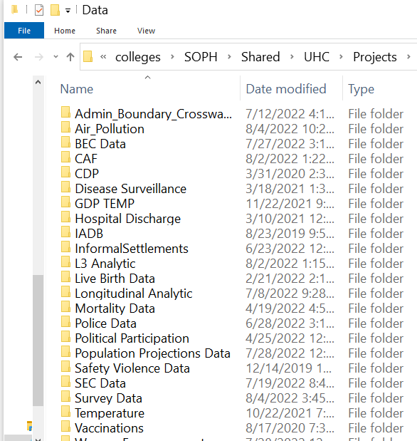
Data Harmonization (pre-FAIR)
Mortality (Jane)
Methodology was excellent across working groups
No explicit structure established across working groups: data format, variable naming conventions, codebook format, codebook content, file structures…
The final output was stored in separate folders
Income (Jeff)

Slide 8

🤕 #1: Can’t find data
What data is available?
Do I have to click every folder individually and check every data file?
Users
(researchers)

Slide 9

🤕 #2: access is human intensive
Mortality (Jane)
Can I have income and mortality data?
Income (Jeff)
Health (James)
SALURBAL
(staff)
Users
(researchers)

Slide 10
🤕 #2: access is human intensive
Mortality (Jane)
Manually pull income data
Manually pull mortality data
Manually pull income metadata
Manually pull mortality metadata
Manually wrangle and merge data
Manually wrangle and metadata
Manually QC
Manually send merged data to user
Income (Jeff)
Health (James)
SALURBAL
(staff)
Users
(researchers)

Slide 11
🤕 #3: no big picture
If data was in one data structure… I could:
Figure how many variables I have?
Automate data distribution
Control access to data
Build analytic tools
ETC
Income (Jeff)
Health (James)
SALURBAL
(staff)
Users
(researchers)

Slide 12
FAIR Renovations
Mortality (Jane)
Design a SALURBAL wide informatics standard (variable naming, data format, metadata format) applied at the work group level.
Income (Jeff)
Health (James)
Notes:
So to address that we

Slide 13
FAIR Renovations
Mortality (Jane)
Design a SALURBAL wide informatics standard (variable naming, data format, metadata format) applied at the work group level.
Compiled SALURABL data into a single database
Income (Jeff)
Health (James)

Slide 14


FAIR Renovations
Mortality (Jane)
Design a SALURBAL wide informatics standard (variable naming, data format, metadata format) applied at the work group level.
Compiled SALURABL data into a single database
Create a user-friendly data portal to access/download data, metadata and reproject outputs.
Income (Jeff)
Health (James)
Notes:
This whole process has been a lot of work and we are still working on it. Before we go on to demo the portal itself. I want to take a moment to thank the renovation team (Kari, Diana and Ana-lu) and the DMC for being great teammates and for everyone’s hard work through out the process.

Slide 15
SALURBAL FAIR Web Interface
Disclaimer: this is a still in pre-release and we are not releasing this until September 2023.
data.lacurbanhealth.org
Notes:
Navbar > pages and cart and login
Home page
Data > About
Data > Catalog
Feature Tour
Variable specific page
Data catalog add a few variables
Checkout
Tools
City Profiles
Analytics tool
Other stuff

Slide 16
FAIR Implementation: 5 lessons
Data Science tools to implement FAIR
Open source software
DDI/ICPCSR integration into global FAIR movement
Project specific web development
Culture change is hard but worth it. Embracing FAIR as a core design principle in large scale research projects
Notes:
I hope the brief demo has given everyone a big picture of the state of the SALURBAL data portal. Before we talk about next steps, I want to take a few minutes to how we got here. How we went from an idea of a SALURBAL portal to the product we saw today. More specifically highlighting two things: collaborative development process and software best practices.

Slide 17
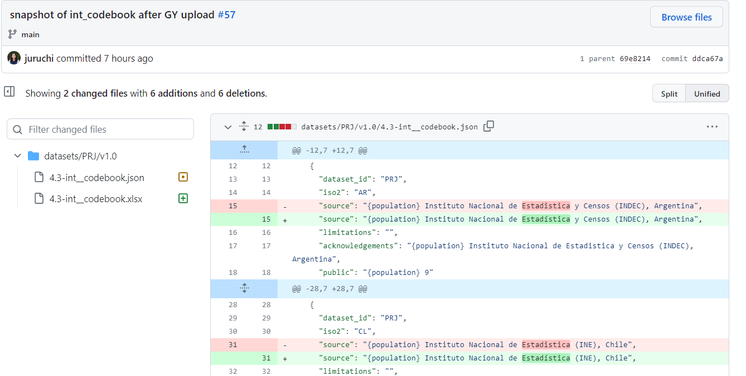
Data Science Tools: GitHub
Version Control
GitHub for collaboration + project management
https://github.com/Drexel-UHC/salurbal-fair-renovations/issues/57

Slide 18
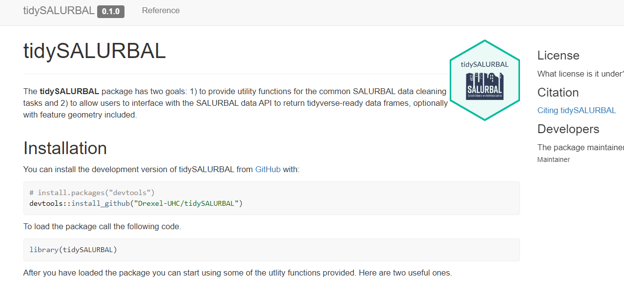
Open Source Software
Utilize open source software to work in an international setting
Build project specific software based on open source languages such as R
https://drexel-uhc.github.io/tidySALURBAL/

Slide 19


Persistence + Integration: DDI/ICPSR
After FAIR renovation and we have machine actionable data/metadata
Integrate with global research community using a common metadata standard (DDI)
To deposit to a mature and persistent repository (ICPSR)

Slide 20

Web Development: custom interfaces
Utilize modern web development to build custom interfaces to fulfill needs specific to our project
Tell data stories to a larger audience
Build tools/features that are fit well with our own team

Slide 21
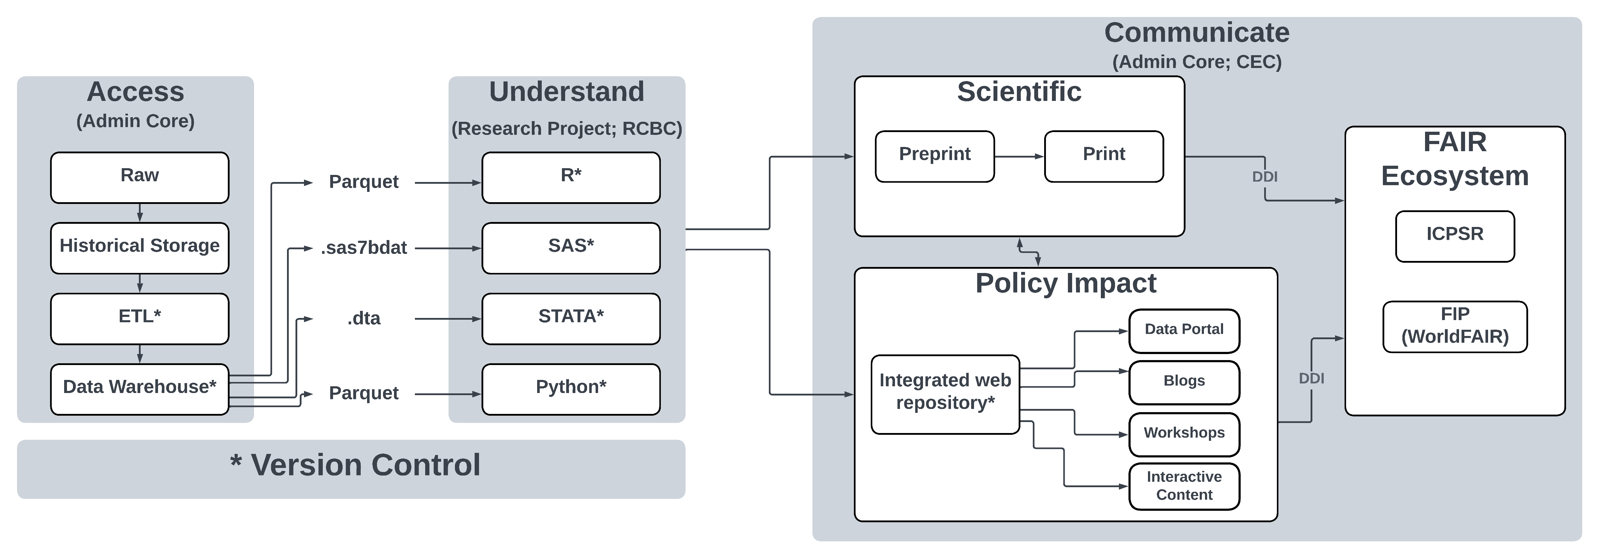
Culture Change
Organization culture change is hard
But glad to say that FAIR has fundamentally change our organization for the better

Slide 22


